Slide 1
Literature Review: “A review on the non-thermal plasma-assisted ammonia synthesis technologies”
Source Authors: Peng et. al.
Reviewers: Tora Gao, Zheng Shi, Leon Zhang

Slide 2

Document Format
A review article published in the Journal of Cleaner Production
Peer-reviewed academic journal
Review articles summarize the current state of understanding on a topic
This journal focuses on “Cleaner Production, Environmental, and Sustainability research and practice”. (https://www.journals.elsevier.com/journal-of-cleaner-production)
https://www.journals.elsevier.com/journal-of-cleaner-production
Notes:
Aka this article reviews and summarizes non-thermal plasma-assisted ammonia synthesis technologies

Slide 3
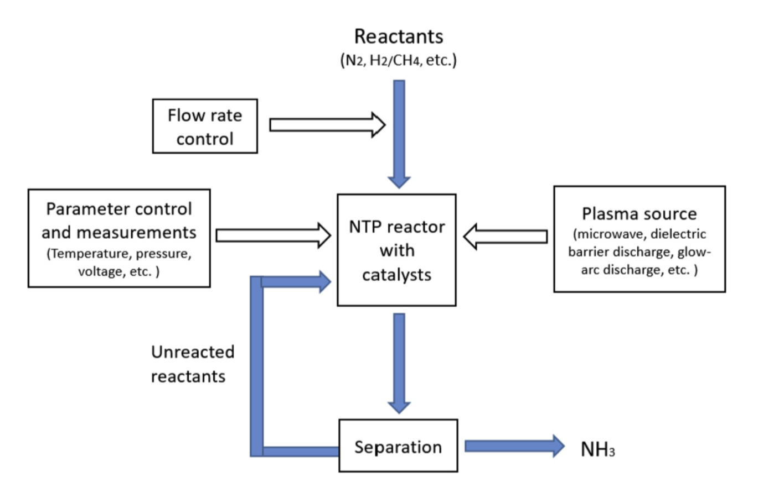
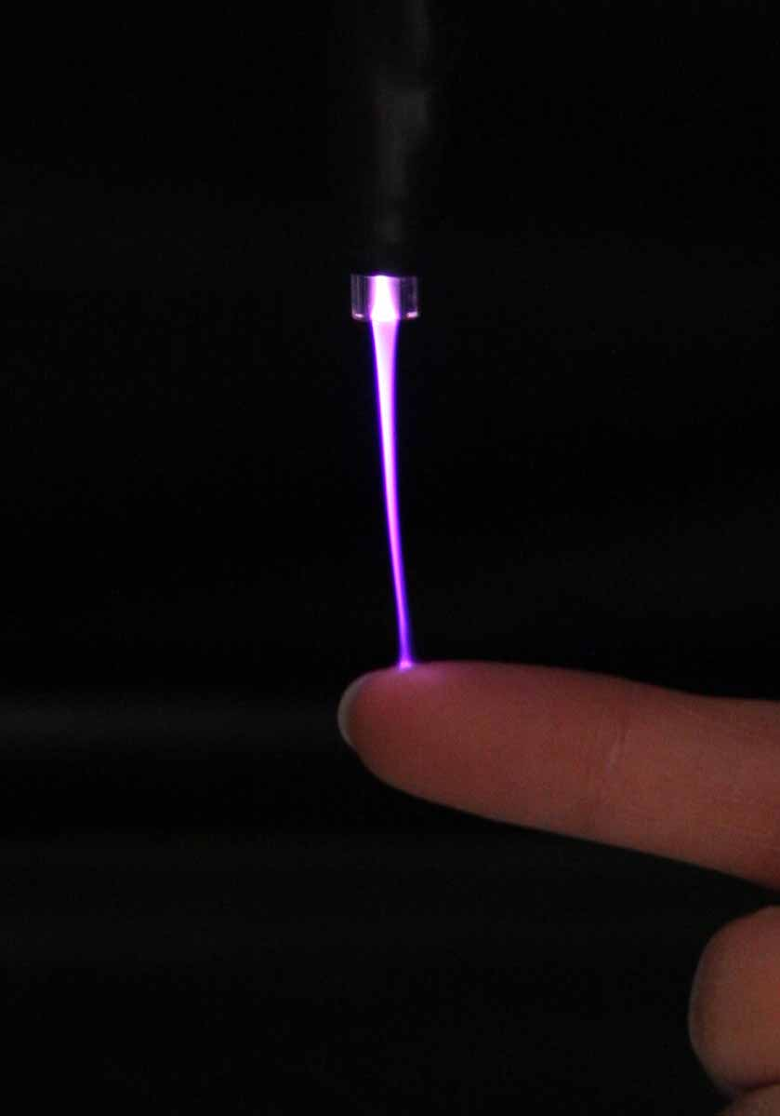
NTP Overview
Non-thermal plasma
Aka cold plasma
BFD for NTP ammonia synthesis
(Diagram from the literature)

Slide 4
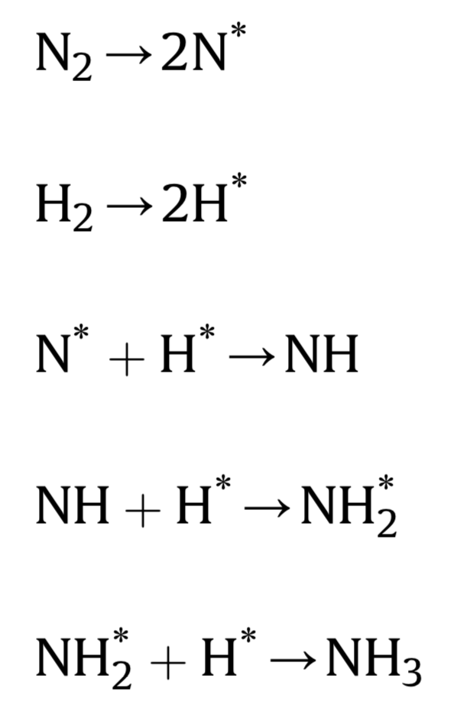

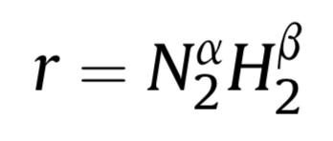

Reactions
Reaction mechanism:
Habor Botch: ~450 C and 200 atm without use of cold plasma
NTP: can operate at room temperature and pressure.
Feed rate: optimal at stoichiometric ratio (N2:H2 = 1:3)

Slide 5
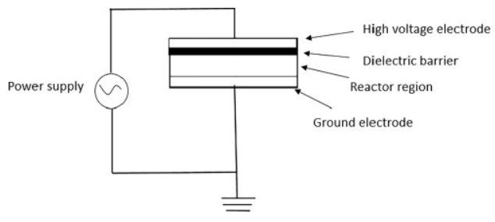
Reactor development
Microwave and RF plasma: achieved at 700 Pa, vacuum, in batch reactors.
Dielectric barrier discharge (DBD)
Optimum voltage frequency: 1 kHz to 10 MHz.
Comparison:
DBD: higher electron density, less temperature increase, continuous operation.
Ferroelectric packed bed reactor: N2 to NH3 conversion of 8%.
Current type: AC used more common than DC, AC has better energy efficiency and conversion.
Notes:
RF=radio frequency

Slide 6
Catalyst development
Presence of catalysts:
Without catalyst
Improve result with quenching gas Ar, He
Types of catalysts:
Monometallic: Cu and MgO
Catalyst-support system(coat ruthenium and carbon on MgO), increase energy efficiency
Catalyst-promoter system (enhance the synthesis efficiency and conversion rate ). Promoters: alkaline metals, typically Cs, Ba, and K
Shape and structure of catalysts:
Powders (not suitable, tend to spread under plasma condition), wires, and pellets
Wool-like copper catalyst is better (larger surface area, allow more discharge)

Slide 7
Major Findings & Relevance to Problem Statement
Reduced Reaction Conditions
Lower temperature and pressure
Haber-Bosch
Temperature: 400–650 °C
Pressure: 60 – 180 bar
NTP
Temperature: 20–200 °C
Pressure: ≤ 1 bar
Reduced operating/capital costs, energy usage, equipment size
Cleaner Ammonia Production
Efficient utilization of renewable wind energy
Circumvents fossil fuel usage
Reduced energy usage
Minimize carbon footprint
Localized and Small-Scale Process
Small-scale is fitting for localized operation
Small-scale design is suited for modular manufacturing

Slide 8
Source Citation
Peng, P., Chen, P., Schiappacasse, C., Zhou, N., Anderson, E., Chen, D., … Ruan, R. (2018). A review on the non-thermal plasma-assisted ammonia synthesis technologies. Journal of Cleaner Production, 177, 597–609. doi: 10.1016/j.jclepro.2017.12.229

